Slide 1
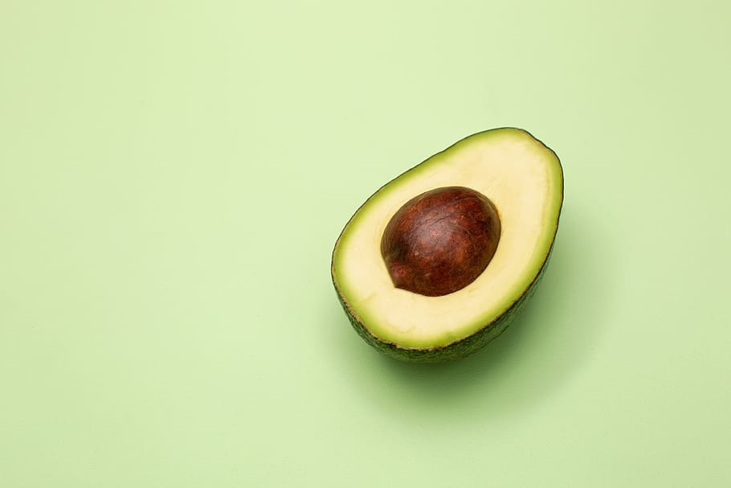
Final Presentation
Avocado Price and Sales Prediction System
Yunze Qiu yq2310
Yiran Lin yl4628
Stacy Lai sl4450
EECS 6893: Yiran Lin, Yunze Qiu, Stacy Lai

Slide 2
Motivation/Novelty
Surge in Market Value
Heavy industry-funded research of marketing campaigns
Rise in consumption and sales revenue
Avocado industry increased at a steady rate from 2019 12.82 billion dollars to 14.33 billion dollars in 2021. Growth is projected to continue increasing at a steady rate until 2025 to 17.91 billion dollars
Change the images of avocado as one of the superfoods that beneficial for your health.
Goal: Build a system which can predict the price and consumption of avocados in certain markets as well as to generate a visual data report by analyzing the marketing data of avocados.
Notes:
Existing dataset: 14 attributes and 18250 observations. Next we will move to methods!

Slide 3
Business Value
Bridge the gap among previous works, where we can build a system that allows users:
Estimate the price and consumption level of avocado
help sellers in the process of demand planning
estimate the sales revenue
A visual data report analyzing the consumer purchasing behavior in the U.S.
present marketing insights of consumer buying behavior, ex: the most sought-after type of avocado and how preferences vary by region across the U.S.
Notes:
Existing dataset: 14 attributes and 18250 observations. Next we will move to methods!

Slide 4
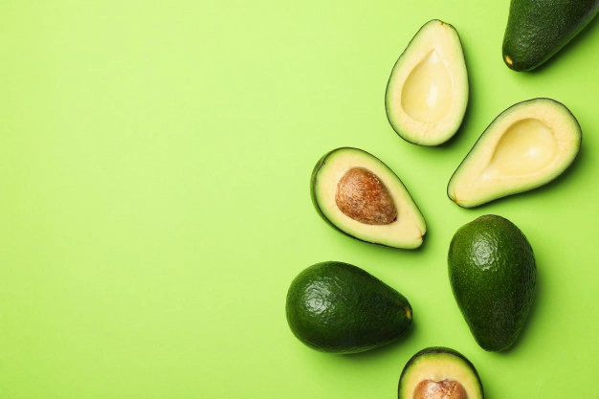
System Overview
Historical Data Visualization System
Project
Price
Prediction System
Consumption
Revenue
Type
Month
Region
User Input

Slide 5
Data
Year
Date
Month
Average Price
Historical Data
Day
Feature selection
Total Volume
Record
Record
Average Price
Three years Data with more than 18k records and 14 features
Total Volume
Type
Region
Region
Notes:
Existing dataset: 14 attributes and 18250 observations. Next we will move to methods!

Slide 6
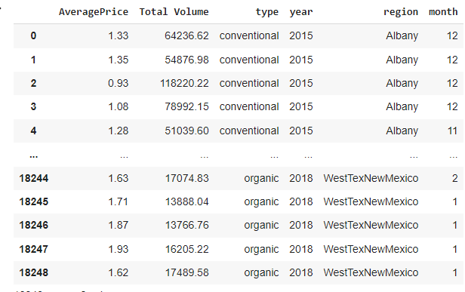
Year
Month
Day
Record
Average Price
Total Volume
Type
Region
Notes:
Existing dataset: 14 attributes and 18250 observations. Next we will move to methods!

Slide 7
Year
Month
Month
12 x 1 vector
Day
Average Price
Average Price
One Hot encoder
Record
Record
Total Volume
Total Volume
0 (conventional)
Type
Training Data
1 (organic)
Type
Region
54 x 1 vector
Region
Notes:
Existing dataset: 14 attributes and 18250 observations. Next we will move to methods!

Slide 8

Model
Linear Regression
Bayes Ringe
Ridge regression
Random Forest
Support Vector Machine
Multilayer Perceptron
Notes:
Existing dataset: 14 attributes and 18250 observations. Next we will move to methods!

Slide 9
Training
Month
Month
Training Data
X
Type
Average Price
Region
80%
Record
Total Volume
20%
Type
Average Price
Testing Data
Y
Region
Total Volume
Notes:
Existing dataset: 14 attributes and 18250 observations. Next we will move to methods!

Slide 10
Experiments
 | Linear Regression | Bayes Ridge | Ridge regression | Random Forest | Support Vector Machine | Multilayer Perceptron
R2 | 0.6164 | 0.6162 | 0.6164 | 0.4587 | 0.6566 | 0.6417
MAE | 0.1909 | 0.1909 | 0.1908 | 0.2293 | 0.1762 | 0.1851
MAPE | 0.1362 | 0.1362 | 0.1362 | 0.1651 | 0.1278 | 0.1299
Notes:
Existing dataset: 14 attributes and 18250 observations. Next we will move to methods!

Slide 11
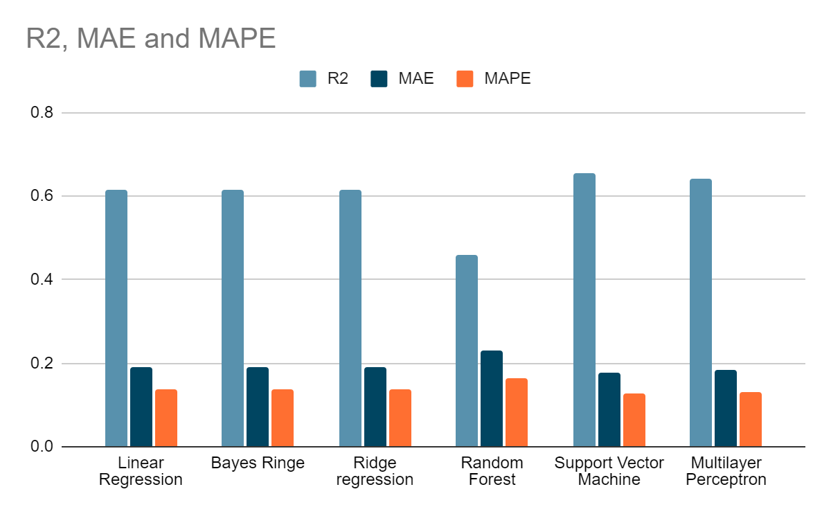
Experiments
Notes:
Existing dataset: 14 attributes and 18250 observations. Next we will move to methods!

Slide 12
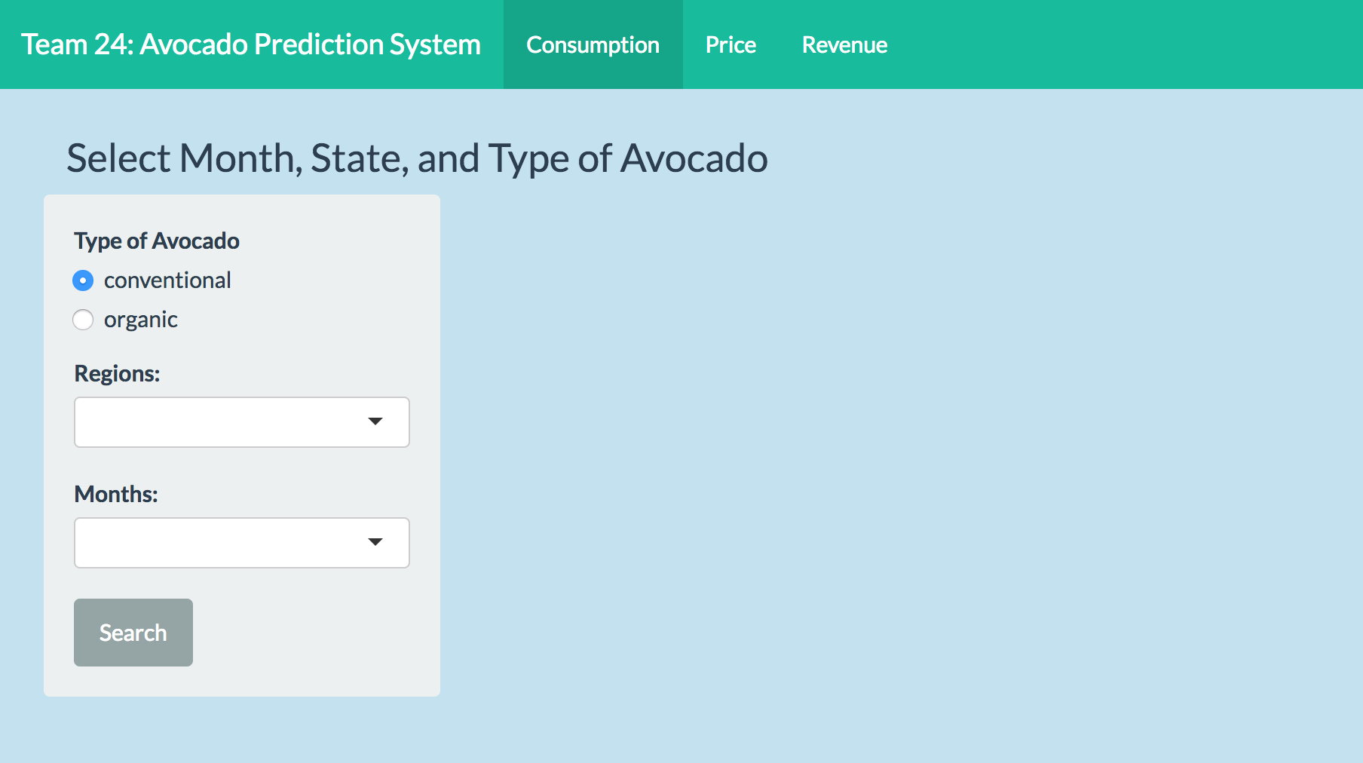
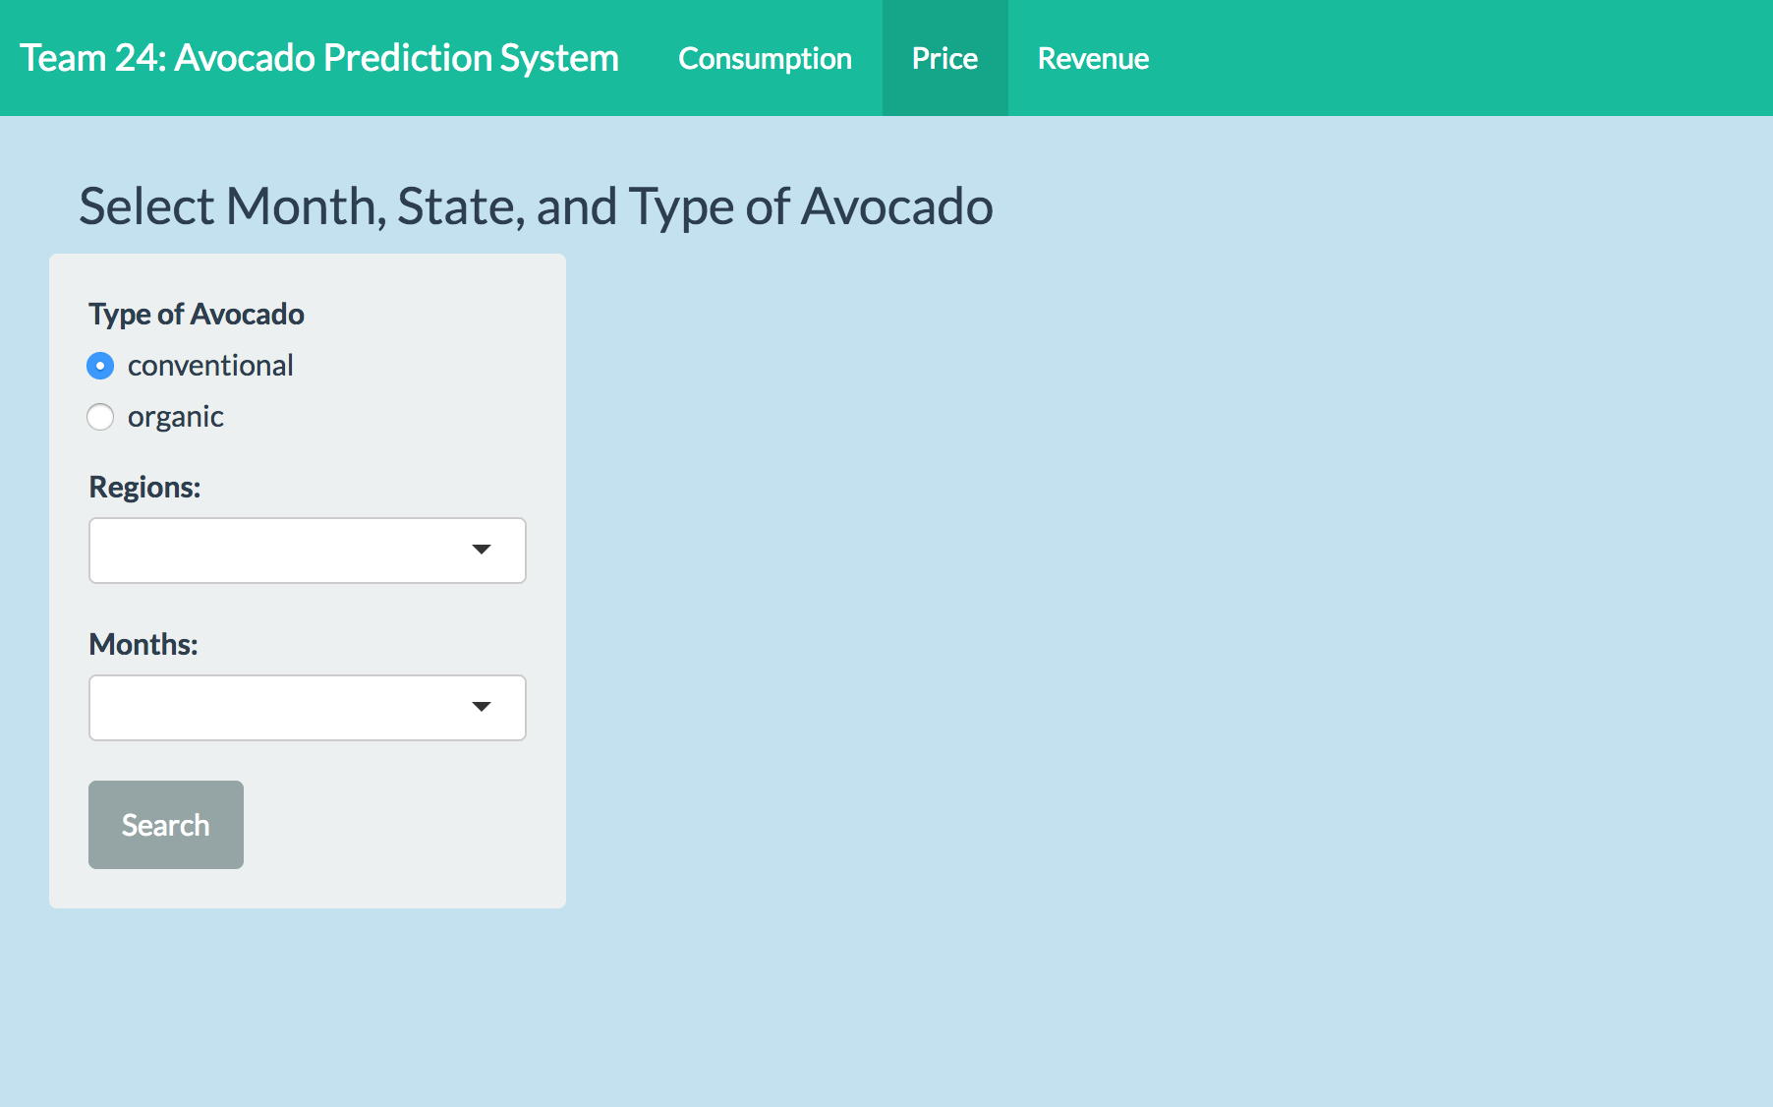
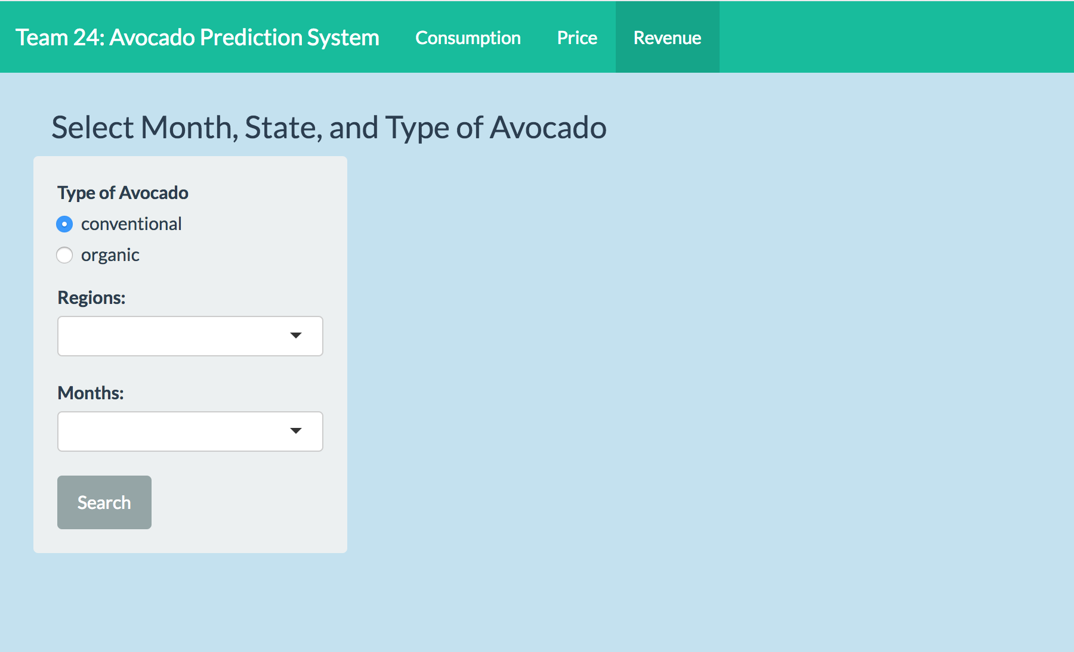
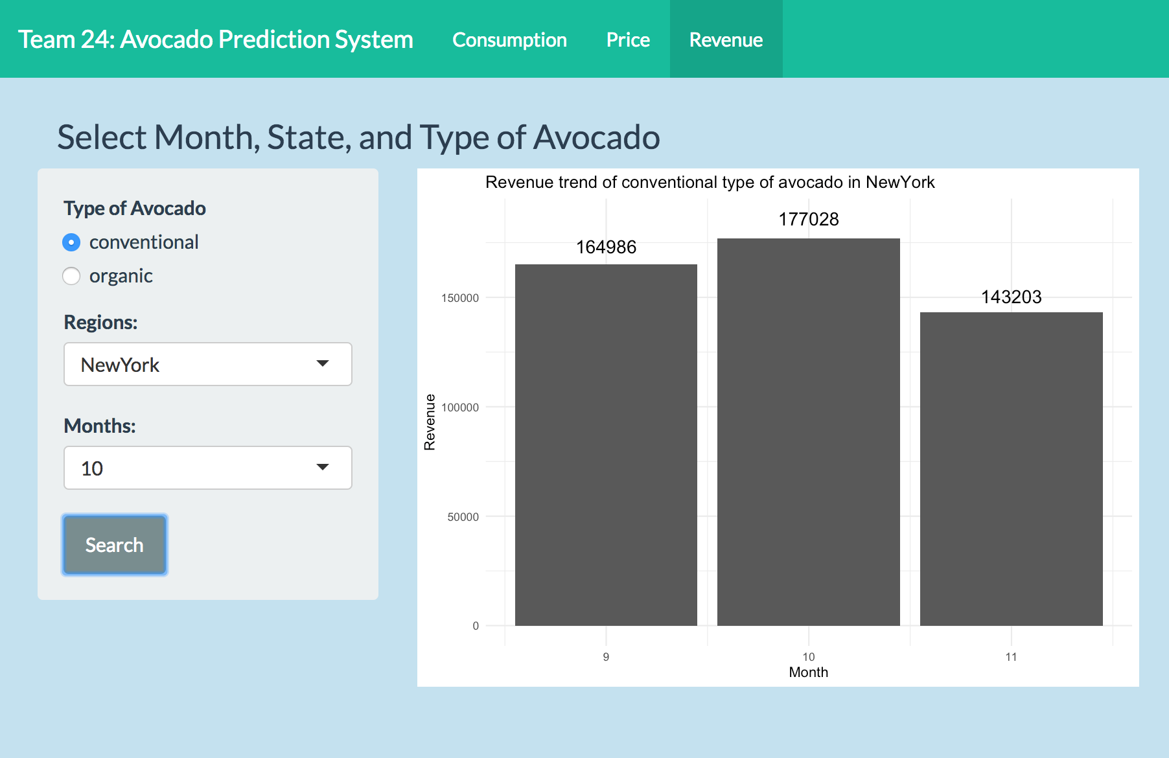
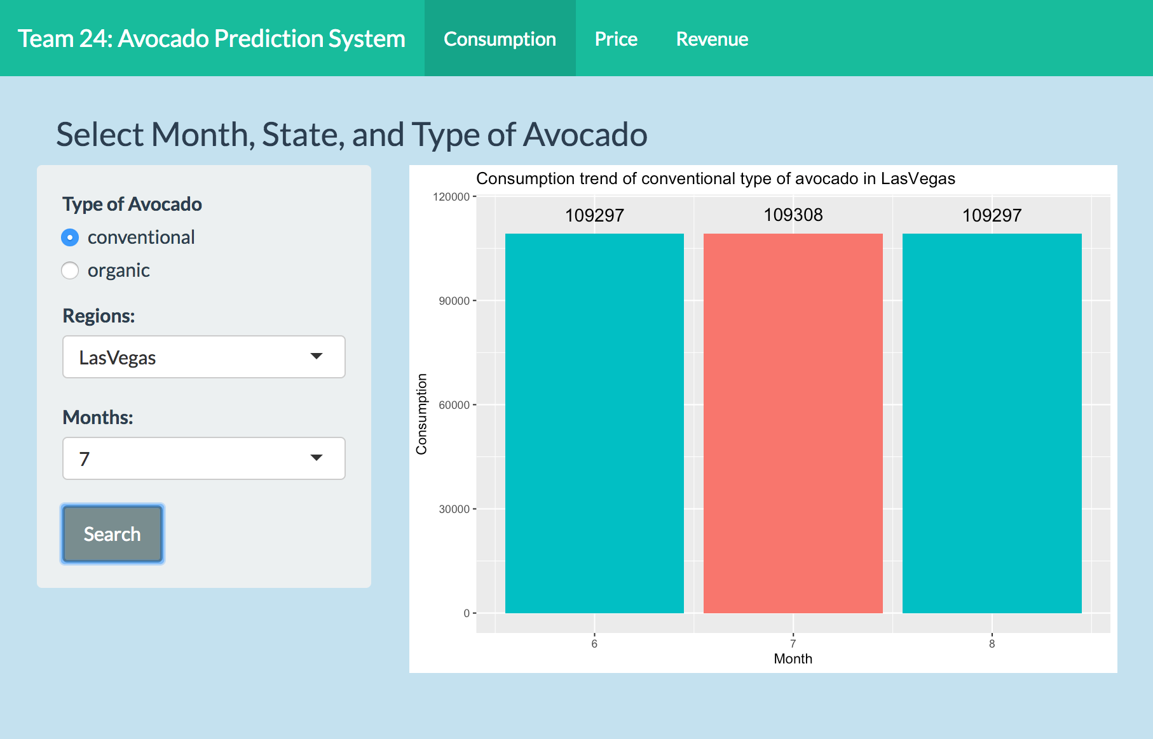
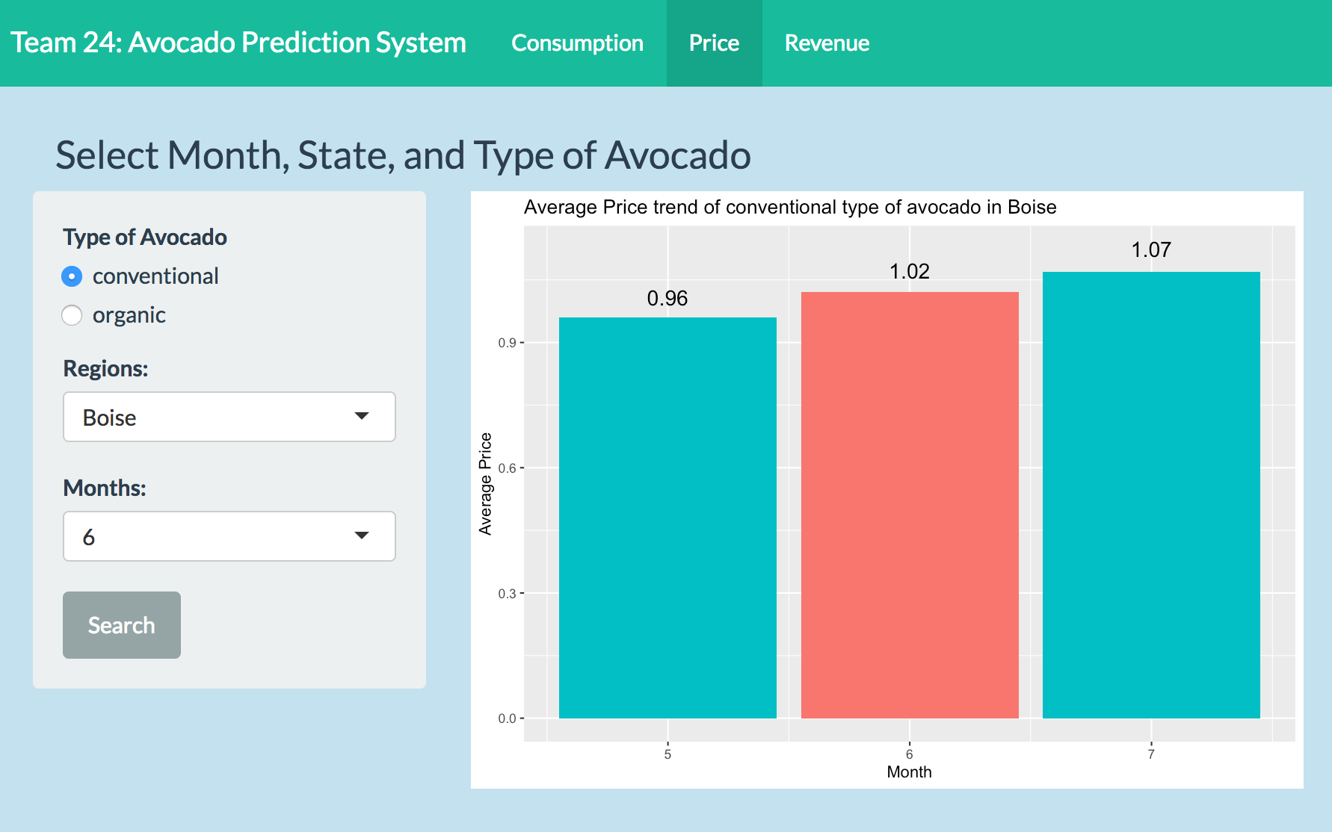
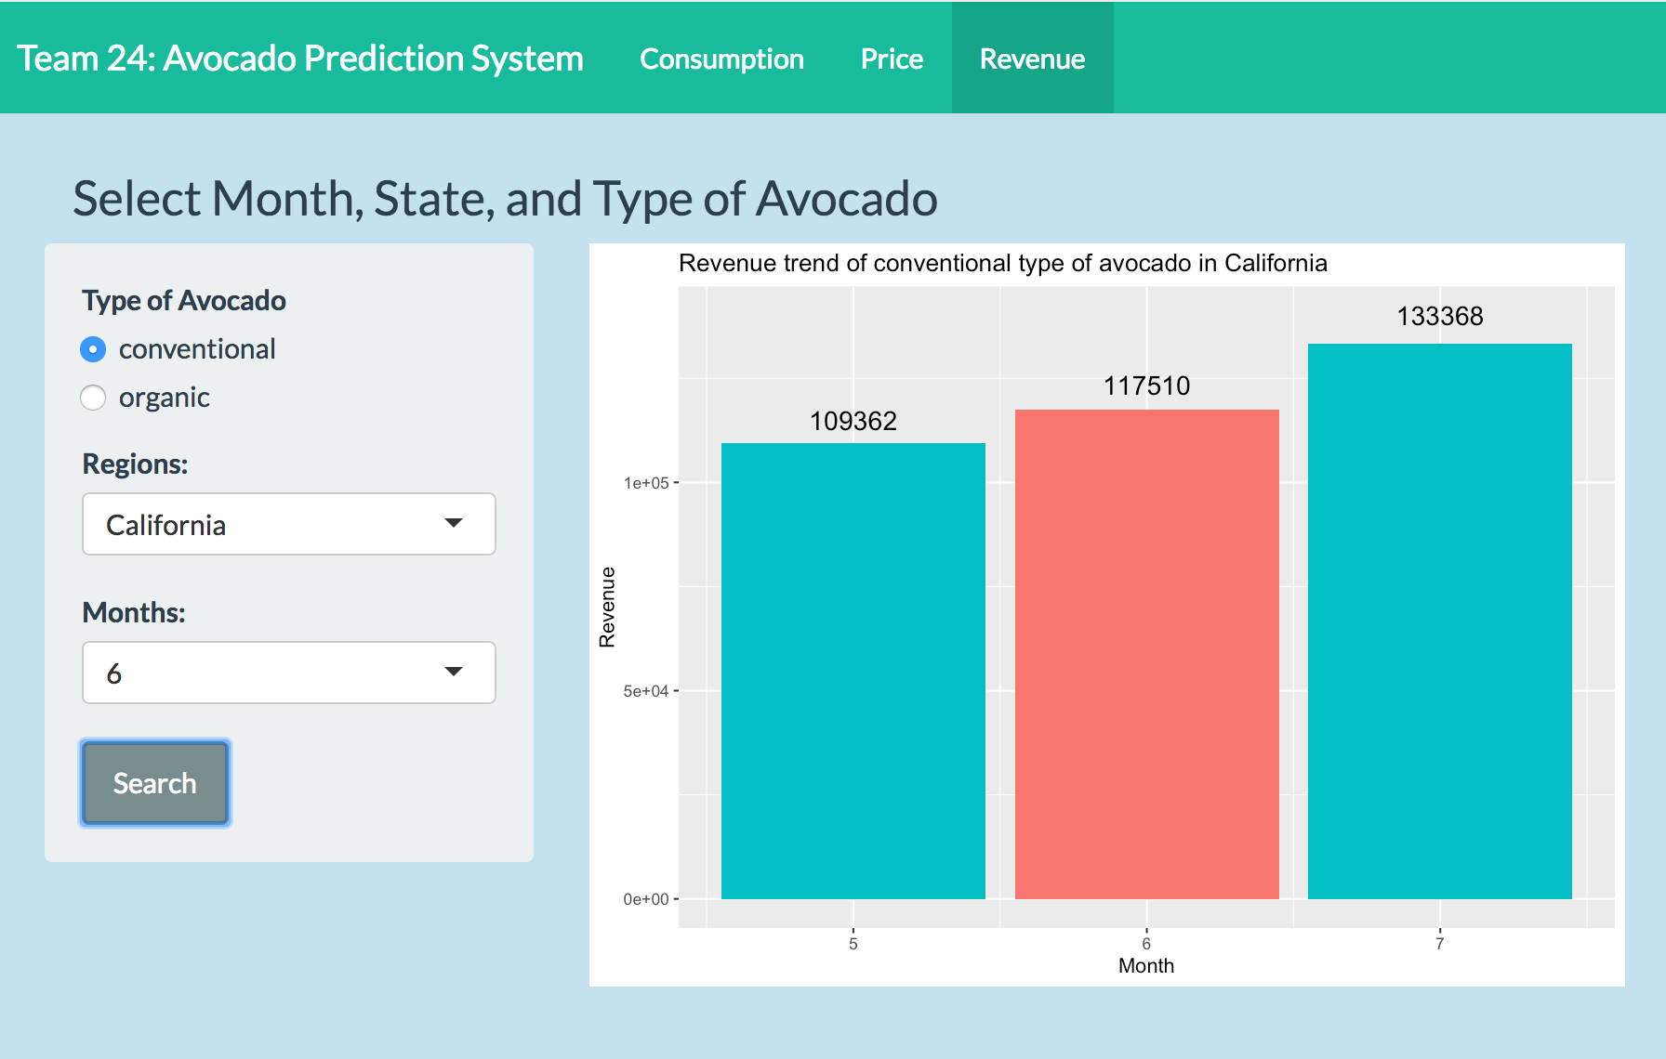
Prediction System Screenshot
Consumption
Price
Revenue
Notes:
Existing dataset: 14 attributes and 18250 observations. Next we will move to methods!

Slide 13

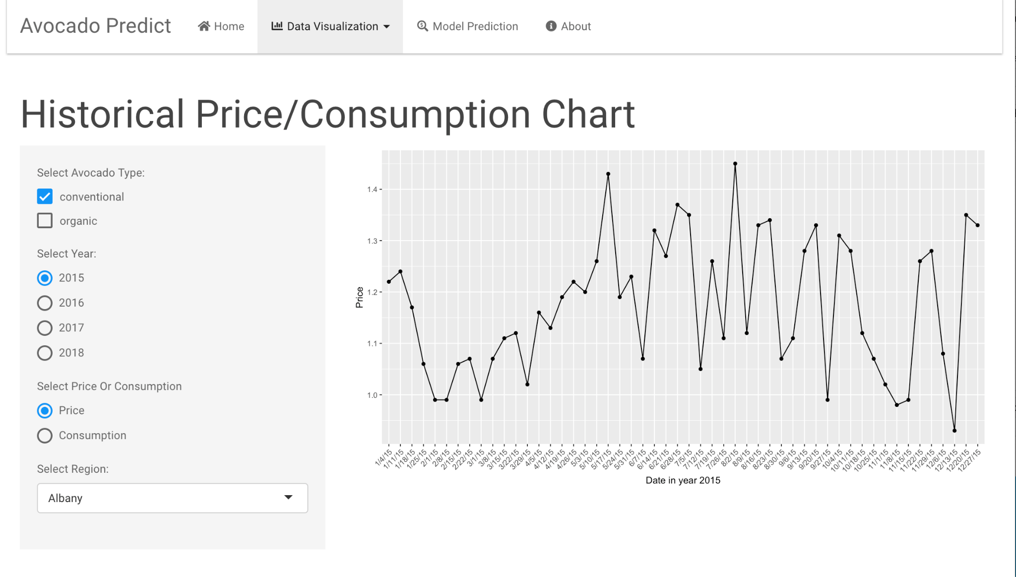
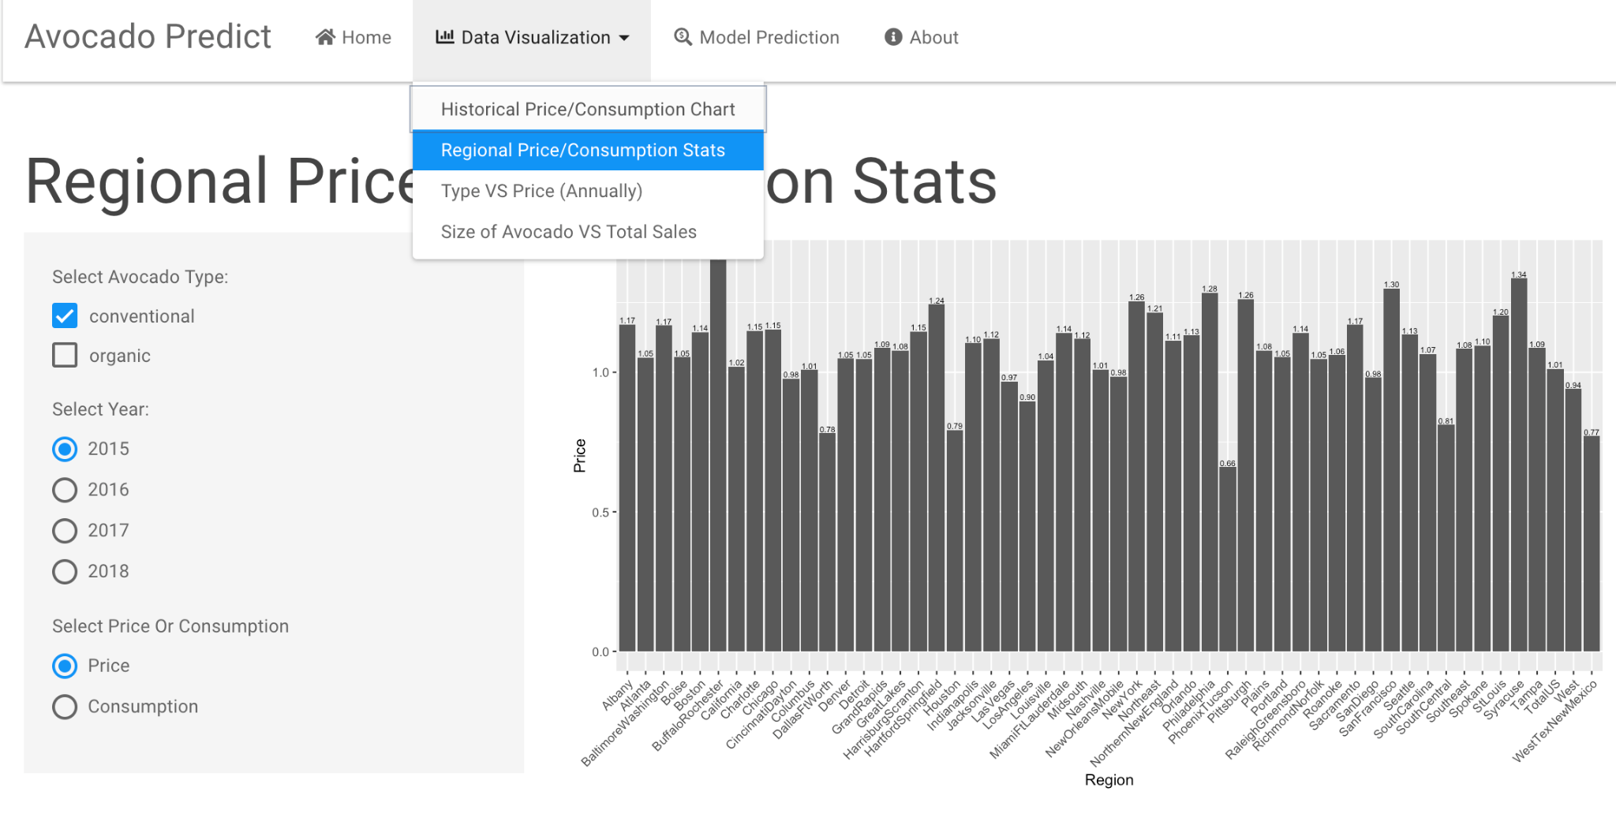
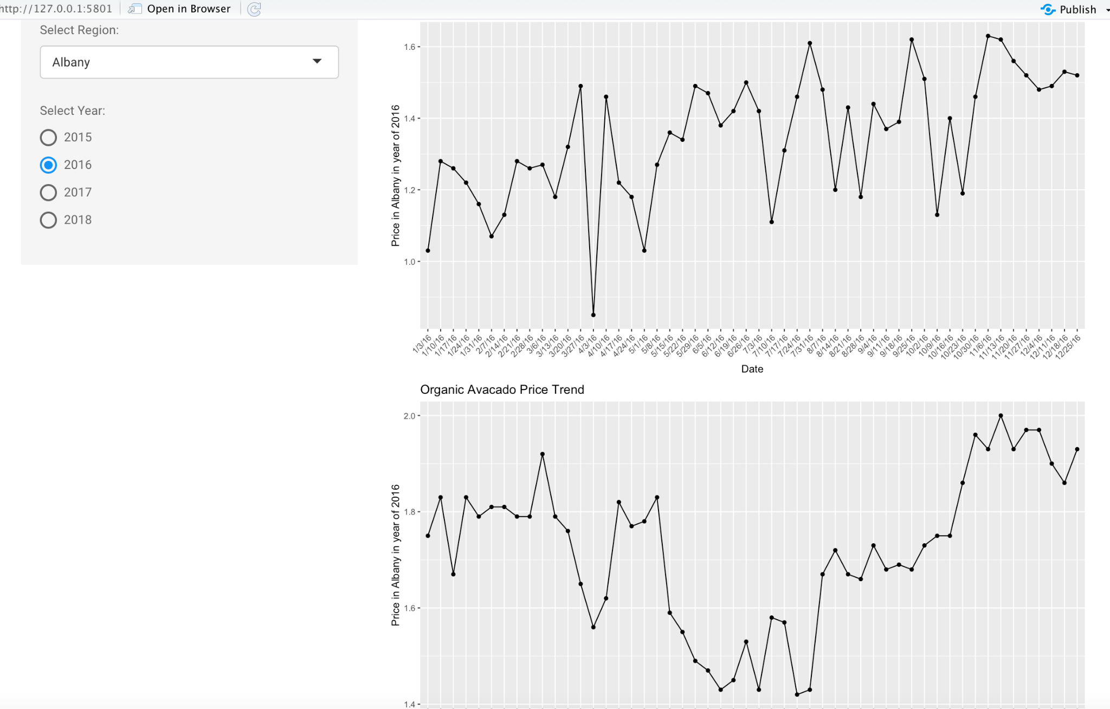
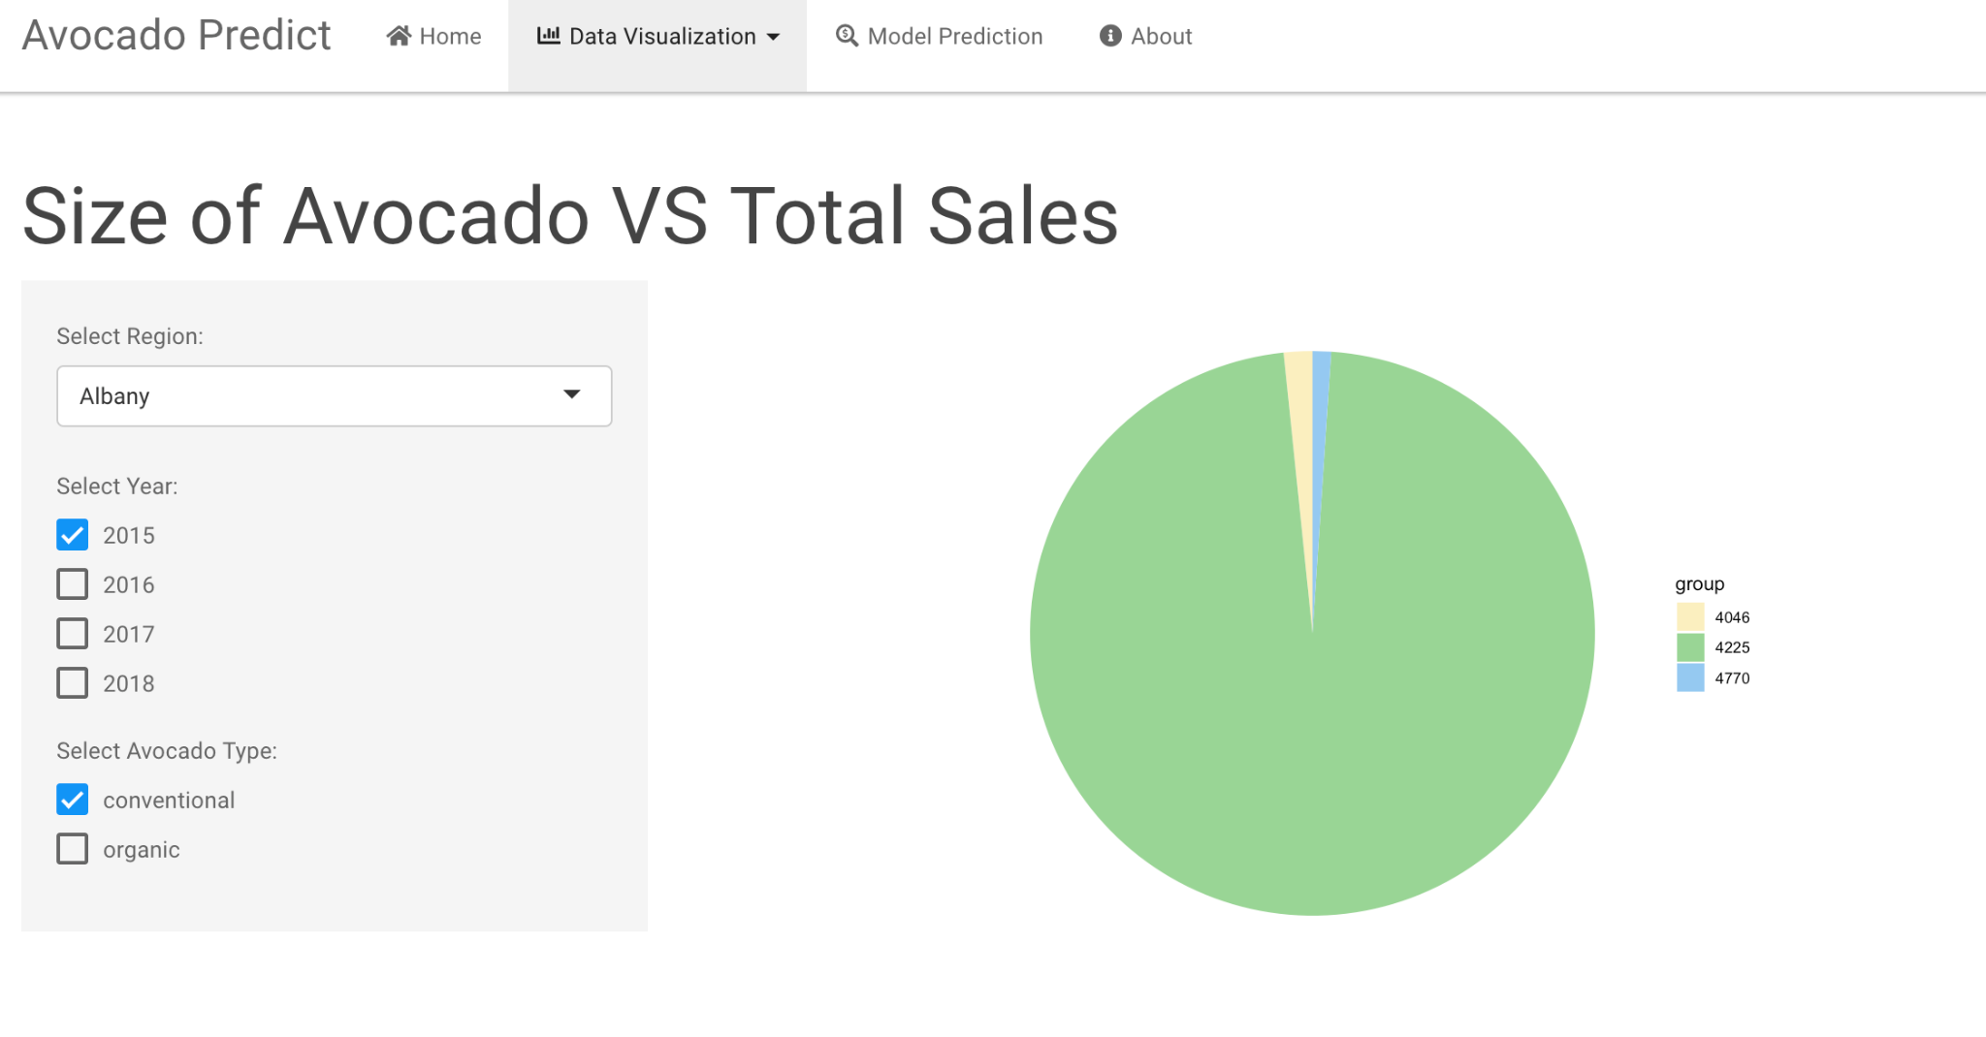
Data Visualization using Shiny

Slide 14
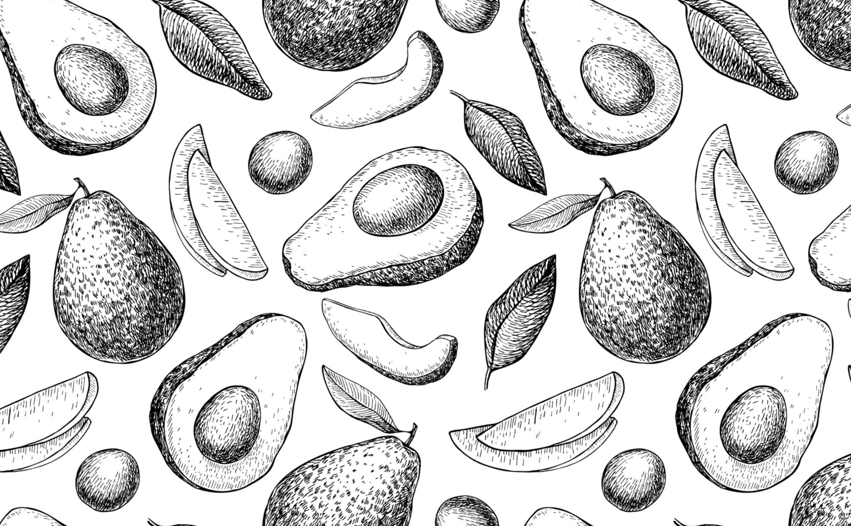
Reference/Related Works
[1] Rincon-Patino, Juan & Lasso, Emmanuel & Corrales, Juan. (2018). Estimating Avocado Sales Using Machine Learning Algorithms and Weather Data. Sustainability. 10. 3498. 10.3390/su10103498.
[2] Evans, E. A., & Ballen, F. H. (2015). An econometric demand model for Florida green-skin avocados. HortTechnology, 25(3), 405-411.
[3] Jones, V., Keyse, K., Melgoza, A., Perez, K., Qamar, T., Villalpando, J., & Woo, J. (2021). Avocado Buying Trends in the United States Using SAC. arXiv preprint arXiv:2104.04649.

